Slide 1
Visualising Employee Attendance Trends with Excel Charts
STUDENT NAME: M.Jannathul Firthoes
REGISTER NO: 312207799
DEPARTMENT: Commerce
COLLEGE: The Quaide milleth college for men.

Slide 2
PROJECT TITLE:
Visualising Employee Attendance Trends
with Excel Charts.

Slide 3


AGENDA:
Problem Statement
Project Overview
End Users
Our Solution and Proposition
Dataset Description
Modelling Approach
Results and Discussion
Conclusion
3/21/2024 Annual Review

Slide 4

PROBLEM STATEMENT:
I can help with that! Here's a potential problem statement for visualizing employee attendance trends with Excel charts: *Problem Statement:* As an HR Analyst, I need to analyze and visualize employee attendance trends to identify patterns, anomalies, and areas for improvement. I have a dataset containing employee attendance records, including dates, attendance status (present, absent, late, etc.), and employee information (department, role, etc.). I want to create interactive and dynamic charts in Excel to: 1. Show attendance trends over time (monthly, quarterly, annually) 2. Compare attendance rates across departments and roles 3. Identify top performers and underperformers 4. Highlight anomalies and outliers (e.g., unusual absenteeism patterns) 5. Track the impact of attendance initiatives and policies on employee attendance *Desired Outcomes:* 1. Interactive charts and dashboards to facilitate exploration and analysis 2. Clear and actionable insights into employee attendance trends 3. Identification of areas for improvement and optimization 4. Data-driven recommendations for attendance initiatives and policies *Dataset:* | Employee ID | Date | Attendance Status | Department | Role | | --- | --- | --- | ---
1. Monitor attendance rates over time for individual employees and 2. Compare attendance performance across departments and locations. 3. Identify top performers and employees with poor attendance records. 4. Detect patterns and anomalies in attendance data, such as seasonal fluctuations or unusual absences. 5. Communicate insights and trends to management and team leaders to inform data-driven decisions.

Slide 5

PROJECT OVERVIEW:
.
Employee Attendance Trends Visualization Objective: Track and analyze employee attendance trends Deliverables: Excel dashboard, user guide, data dictionary KPIs: Attendance Rate, Absenteeism Rate, Average Days Absent Top Performers and Poor Attendance Records Timeline: 10 days Resources: Excel software, HR attendance data Project team: HR manager, data analyst, Excel expert Create an interactive and dynamic Excel dashboard Enable HR managers to make data-driven decisions

Slide 6

WHO ARE THE END USERS?
1. HR Managers 2. Team Leaders 3. Department Heads 4. Operations Managers 5. Business Analysts 6. Management Team 7. Supervisors 8. Employee Relations Specialists 9. Payroll Managers 10. Decision-makers who need attendance insights

Slide 7

OUR SOLUTION AND ITS VALUE PROPOSITION:
Solution: Interactive Excel dashboard visualizing employee attendance trends and patterns. Value Proposition: - Improve attendance tracking and analysis - Inform data-driven decisions - Boost productivity and reduce absenteeism - Enhance employee management and insights - Save time and reduce costs.

Slide 8
Dataset Description:
_Data Set:_ Employee Attendance Records _Fields:_ + Employee ID + Name + Department + Location + Date + Attendance Status (Present, Absent, Late, Left Early) + Reason for Absence (optional) _Format:_ + Date: MM/DD/YYYY + Attendance Status: Categorical _Volume:_ + 100-1000+ employees + 1000-10,000+ attendance records + 1-2 years of data

Slide 9

THE "WOW" IN OUR SOLUTION:
Key "Wow" Elements: 1.Live Attendance Dashboards: Real-time insights into employee attendance trends. 2.Predictive Analytics: Forecast absenteeism and identify areas for improvement. 3Customizable Charts: Personalized views for HR, management, and employees. 4. Automated Reporting: Scheduled reports for timely decision-making. 5.Data-Driven Insights: Uncover hidden trends and correlations to inform HR strategy.
3/21/2024 Annual Review
9

Slide 10
Modeling:
_Data Modeling:_ - Source: HR attendance records - Transformation: Clean, format, and aggregate data - Visualization: Interactive Excel charts and dashboards _Key Models:_ - Attendance Rate - Absenteeism - Predictive - Correlation Modeling Techniques: - Descriptive Analytics - Diagnostic Analytics - Predictive Analytics - Prescriptive Analytics

Slide 11
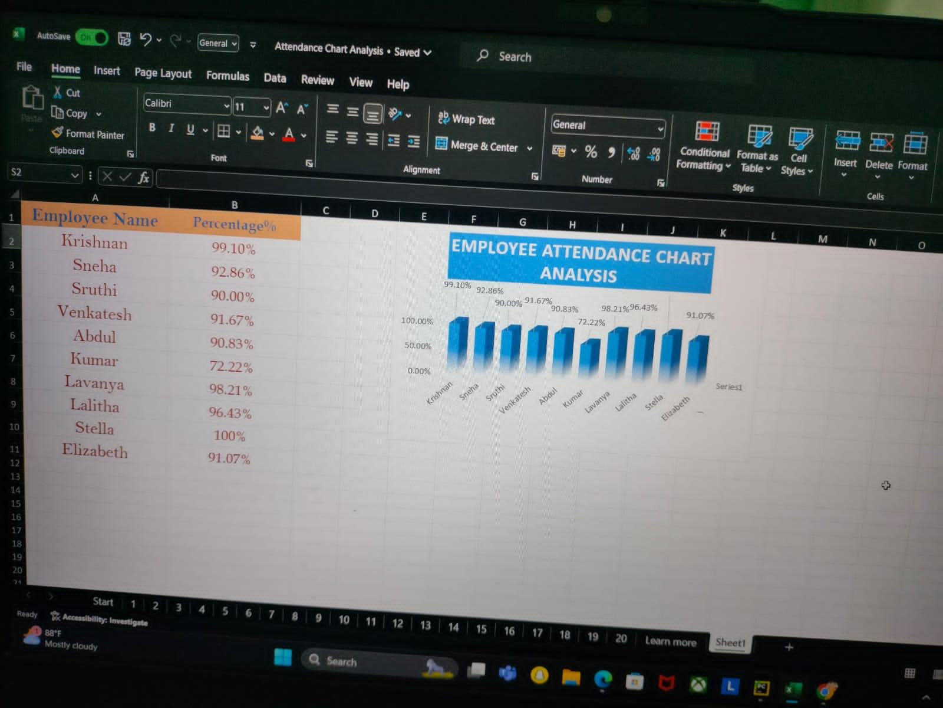
RESULTS:
11

Slide 12
conclusion:
Visualizing employee attendance trends with Excel charts allows for a straightforward analysis of attendance patterns over time. By leveraging Excel’s charting tools, such as line graphs or bar charts, you can effectively track key metrics, identify trends, and spot any anomalies in attendance data. This visual approach simplifies complex data, making it easier to interpret and use for informed decision-making. Consequently, it enhances workforce management by providing clear insights into attendance behaviors and helping forecast future staffing needs.

